Slide 1



NEWTON SCHOOL
TWITTER A/B TESTING
PRESENTED BY KAJAL SINGH

Slide 2

INTRODUCTION AND OBJECTIVES
OBJECTIVE:
EVALUATE THE EFFECTIVENESS OF THE NEW IMPRESSION-BASED AD MODEL IN MINIMIZING CAMPAIGN OVERSPEND. THIS INCLUDES UNDERSTANDING WHETHER IT REDUCES OVERSPENDING OVERALL, HOW COMPANY SIZE MAY INFLUENCE SPENDING BEHAVIOR, AND WHETHER ADVERTISERS ARE ADAPTING TO THE NEW BILLING STRUCTURE.
FOCUS AREAS:
REDUCTION IN CAMPAIGN OVERSPEND
SPENDING PATTERNS ACROSS DIFFERENT ADVERTISER SIZES
BEHAVIORAL ADAPTATION TO THE NEW AD MODEL
THIS ANALYSIS NOT ONLY MEASURES WHETHER THE NEW PRODUCT REDUCES OVERSPEND BUT ALSO UNCOVERS DEEPER INSIGHTS SUCH AS DIFFERENCES IN BEHAVIOR ACROSS ADVERTISER SIZES AND HOW ADVERTISERS ARE RESPONDING TO THE SHIFT IN BILLING STRUCTURE.

Slide 3
DATA OVERVIEW
THE DATASET CONSISTS OF CAMPAIGN-LEVEL AD PERFORMANCE DATA FROM AN A/B EXPERIMENT. EACH ROW REPRESENTS ONE CAMPAIGN INSTANCE WITH FOUR KEY VARIABLES:
Column Name | Description
treatment | Indicates whether the campaign used the new (TRUE) or old (FALSE) ad model
company_size | Categorical variable: small, medium, or large
campaign_spend | Total amount spent by the campaign
campaign_budget | Assigned budget for the campaign

Slide 4
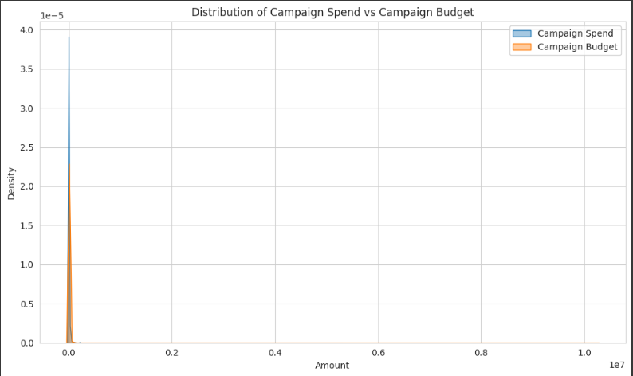
DATA CLEANING
TO ENSURE DATA INTEGRITY AND ENABLE MEANINGFUL ANALYSIS, THE FOLLOWING PREPROCESSING STEPS WERE APPLIED:
HANDLED MISSING VALUES IN KEY VARIABLES TO MAINTAIN CONSISTENCY ACROSS RECORDS.
ELIMINATED DUPLICATES TO AVOID SKEWED METRICS OR REPEATED INFLUENCE FROM THE SAME CAMPAIGN.
PERFORMED A PRELIMINARY REVIEW OF CAMPAIGN_SPEND AND CAMPAIGN_BUDGET TO UNDERSTAND VARIABILITY AND DETECT OUTLIERS OR UNUSUAL PATTERNS

Slide 5
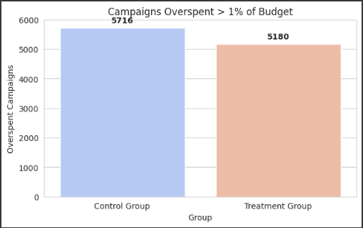
CAMPAIGN OVERSPENDING ANALYSIS
OBSERVATION:
OVERSPENDING WAS OBSERVED IN BOTH THE CONTROL AND TREATMENT GROUPS, THOUGH THE MAGNITUDE DIFFERED.
KEY FINDINGS:
CONTROL GROUP (EXISTING PRODUCT):
🔴 5,716 CAMPAIGNS EXCEEDED THEIR ALLOCATED BUDGETS.
TREATMENT GROUP (NEW PRODUCT):
🟢 5,180 CAMPAIGNS OVERSPENT — INDICATING IMPROVEMENT IN MANAGING OVERSPEND.
INTERPRETATION:
THE NEW IMPRESSION-BASED PRODUCT REDUCED OVERSPENDING COMPARED TO THE CLICK-BASED MODEL.
THIS SUGGESTS A POSITIVE IMPACT OF THE TREATMENT IN TERMS OF BUDGET CONTROL.

Slide 6
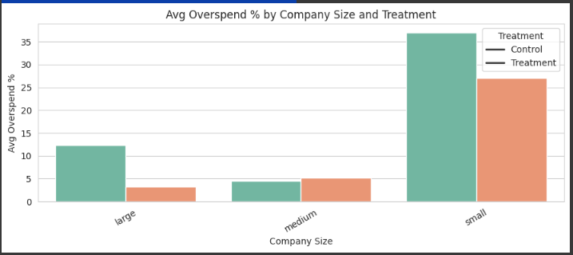
EFFECTIVENESS OF THE NEW PRODUCT BY COMPANY SIZE
KEY OBSERVATIONS:
LargE COMPANIES:
OVERSPEND IMPROVED SIGNIFICANTLY UNDER TREATMENT (FROM ₹-529 TO ₹-3,488),
OVERSPEND PERCENTAGE DECREASED FROM 12.3% TO 3.3%, SHOWING BETTER COST CONTROL DESPITE LARGER ABSOLUTE OVERSPEND (NEGATIVE VALUES IMPLY UNDERSPENDING HERE).
MEDIUM COMPANIES:
TREATMENT REDUCED ABSOLUTE OVERSPEND FROM ₹-1,869 TO ₹-938,
HOWEVER, OVERSPEND PERCENTAGE SLIGHTLY INCREASED FROM 4.6% TO 5.1%, INDICATING A MIXED RESPONSE.
SMALL COMPANIES:
TREATMENT GROUP SHOWED AN INCREASE IN ABSOLUTE OVERSPEND FROM ₹-591 TO ₹231 (INDICATING OVERSPENDING INSTEAD OF UNDERSPENDING),
OVERSPEND PERCENTAGE REDUCED FROM 37.1% TO 27.1%, SIGNALING BETTER BUDGET ADHERENCE BUT SOME OVERSPENDING REMAINS.

Slide 7
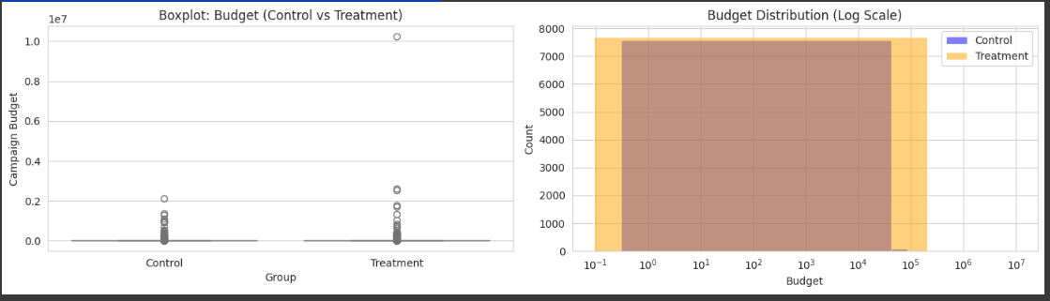
SUSPICION ON CAMPAIGN BUDGETS
KEY FINDINGS:
Summary Statistics:
CONTROL GROUP:
MEAN BUDGET ≈ ₹4,642
MEDIAN BUDGET ≈ ₹65
HIGH VARIATION WITH LARGE STANDARD DEVIATION (~₹47,766)
TREATMENT GROUP:
MEAN BUDGET ≈ ₹6,902 (HIGHER THAN CONTROL)
MEDIAN BUDGET ≈ ₹39 (LOWER THAN CONTROL)
EVEN LARGER SPREAD IN BUDGETS (STD DEV ~₹131,624)
STATISTICAL TEST:
MANN-WHITNEY U TEST P-VALUE ≈ 1.47E-26 (VERY SIGNIFICANT)
INDICATES A STATISTICALLY SIGNIFICANT DIFFERENCE IN BUDGET DISTRIBUTIONS BETWEEN CONTROL AND TREATMENT.

Slide 8
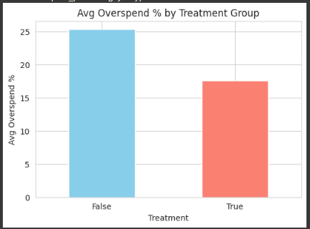
OVERSPEND PERCENTAGE ANALYSIS
KEY METRICS:
CONTROL GROUP: AVERAGE OVERSPEND = 24.5%
TREATMENT GROUP: AVERAGE OVERSPEND = 19.3%
→ IMPROVEMENT OF 5.2 PERCENTAGE POINTS
INSIGHTS:
THE TREATMENT GROUP (NEW AD PRODUCT) HAD LOWER AVERAGE OVERSPEND, INDICATING BETTER BUDGET ADHERENCE.
SUGGESTS THAT ADVERTISERS IN THE TREATMENT GROUP SPENT CLOSER TO THEIR ALLOCATED BUDGETS.

Slide 9
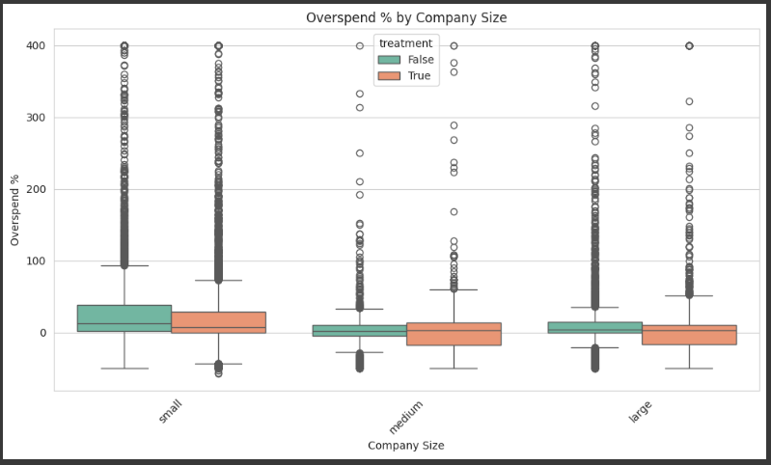
DEMOGRAPHIC INSIGHTS: COMPANY SIZE VS. OVERSPEND
KEY OBSERVATIONS:
SMALL COMPANIES:
→ SIGNIFICANT REDUCTION IN OVERSPEND WITH TREATMENT.
MEDIUM COMPANIES:
→ MODERATE IMPROVEMENT, THOUGH RESULTS WERE MIXED.
LARGE COMPANIES:
→ INCREASE IN OVERSPEND UNDER TREATMENT, INDICATING DIFFICULTY ADAPTING.

Slide 10
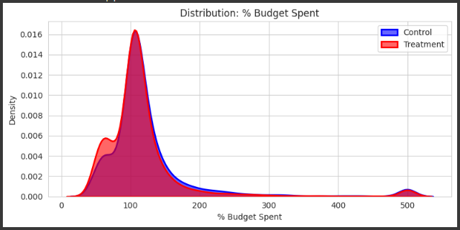
BUDGET UTILIZATION TRENDS
KEY FINDINGS:
TREATMENT GROUP SHOWED HIGHER VARIANCE IN BUDGET USAGE.
REFLECTS DIVERSE SPENDING BEHAVIORS AND POSSIBLY GREATER ADVERTISER CAUTION.
CONTROL GROUP EXHIBITED MORE CONSISTENT SPENDING:
INDICATES STABLE BUT POTENTIALLY OVERSPENDING BEHAVIOR.

Slide 11
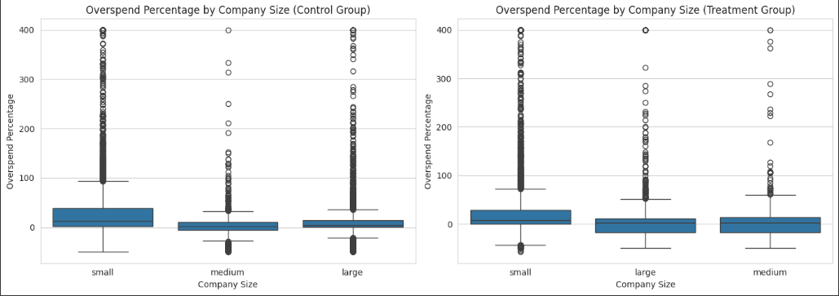
CONSISTENCY IN CAMPAIGN SPEND
STATISTICAL TEST USED:
LEVENE’S TEST FOR EQUALITY OF VARIANCES
NULL HYPOTHESIS (H₀): VARIANCES IN CAMPAIGN SPEND ARE EQUAL BETWEEN THE TWO GROUPS.
RESULT:
P-VALUE > 0.05 → FAIL TO REJECT H₀
NO STATISTICALLY SIGNIFICANT DIFFERENCE IN VARIANCE.
INTERPRETATION:
DESPITE THE REDUCTION IN OVERSPEND PERCENTAGE SEEN IN THE TREATMENT GROUP,
THE VARIANCE IN TOTAL SPEND REMAINS STATISTICALLY CONSISTENT WITH THE CONTROL GROUP.
THIS IMPLIES ADVERTISERS ARE:
ADOPTING THE NEW IMPRESSION-BASED PRODUCT CAUTIOUSLY.
NOT SIGNIFICANTLY ALTERING THEIR OVERALL BUDGET ALLOCATION BEHAVIOR
STRATEGIC TAKEAWAY:
WHILE THE PRODUCT EFFECTIVELY REDUCES UNNECESSARY SPEND, MORE TARGETED EFFORTS (ESPECIALLY FOR LARGE COMPANIES) MAY HELP ALIGN SPENDING PATTERNS FOR GREATER ADOPTION AND IMPACT.

Slide 12
OVERALL EFFECTIVENESS OF THE NEW AD PRODUCT
KEY FINDINGS:
✅ TREATMENT GROUP DEMONSTRATED REDUCED OVERSPEND RATES COMPARED TO CONTROL.
⚖️ MIXED ADOPTION ACROSS COMPANY SIZES:
SMALL & MEDIUM COMPANIES SHOWED POSITIVE RESPONSE.
LARGE FIRMS EXHIBITED HIGHER OVERSPEND AND SLOWER ADAPTATION.
STRATEGIC IMPLICATIONS:
THE NEW PRODUCT IS A PROMISING INITIATIVE, BUT:
REQUIRES TARGETED ONBOARDING OR EDUCATION STRATEGIES FOR LARGE ADVERTISERS.
FURTHER PRODUCT REFINEMENT MAY BE NECESSARY TO FIT VARIED ADVERTISER BEHAVIORS.
CONCLUSION:
📈 POSITIVE INITIAL IMPACT, WITH CLEAR OPPORTUNITIES FOR OPTIMIZATION TO ENSURE WIDESPREAD AND EFFECTIVE ADOPTION ACROSS ALL ADVERTISER SEGMENTS.

Slide 13
STRATEGIC RECOMMENDATIONS
ACTIONABLE STEPS:
TAILORED SUPPORT FOR LARGE ADVERTISERS
→ OFFER DEDICATED GUIDANCE TO HELP LARGE COMPANIES BETTER OPTIMIZE THEIR BUDGETS.
INCREASE TRANSPARENCY & TRUST
→ SHARE CLEAR PRODUCT PERFORMANCE METRICS AND REAL CASE STUDIES TO BUILD ADVERTISER CONFIDENCE.
CONTINUE CONTROLLED EXPERIMENTATION
→ EXTEND A/B TESTING TO REFINE THE PRODUCT, ASSESS EVOLVING ADVERTISER BEHAVIOR, AND ENSURE LONG-TERM EFFECTIVENESS.
ALIGN OUTREACH WITH ADVERTISER OBJECTIVES
→ FOCUS ENGAGEMENT EFFORTS ON HIGH-VARIANCE SECTORS WITH MESSAGING ALIGNED TO THEIR UNIQUE GOALS AND CONCERNS.
“COLLABORATION FUELS MUTUAL SUCCESS.”
PARTNERING CLOSELY WITH ADVERTISERS WILL BE ESSENTIAL TO MAXIMIZE THE PRODUCT’S POTENTIAL AND DRIVE SHARED GROWTH.

Slide 14
THANK YOU

